Slide 1
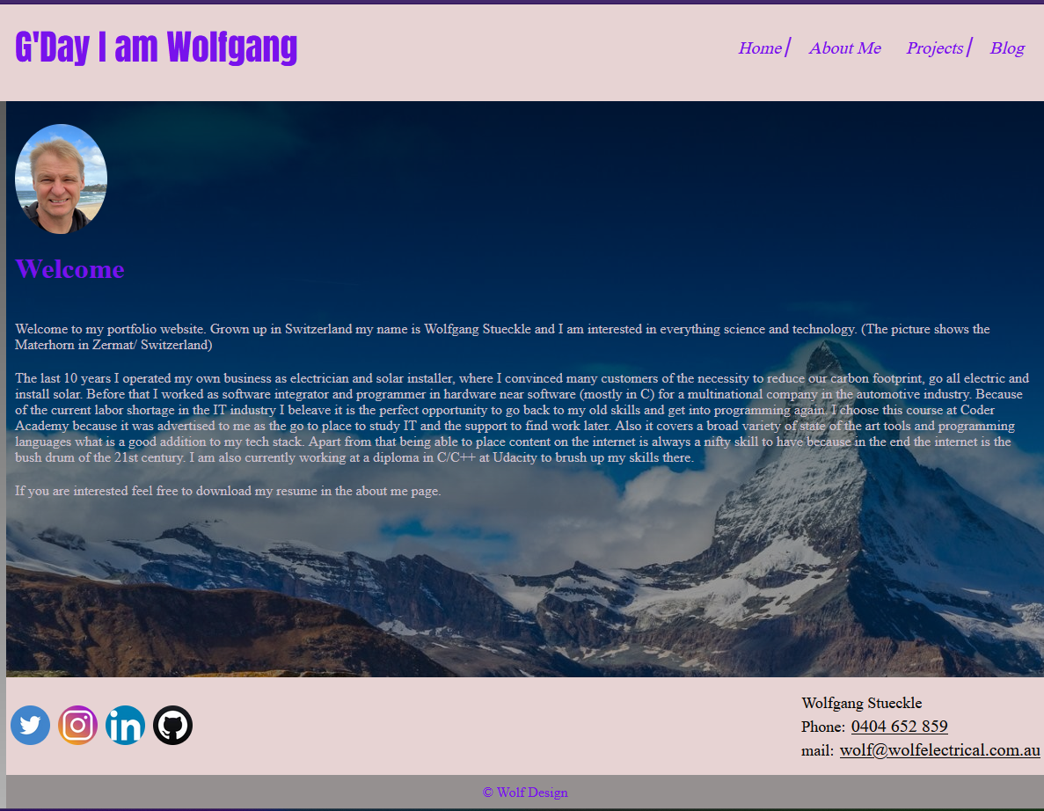

Portfolio walk through, Landing
Notes:
Landing page

Slide 2
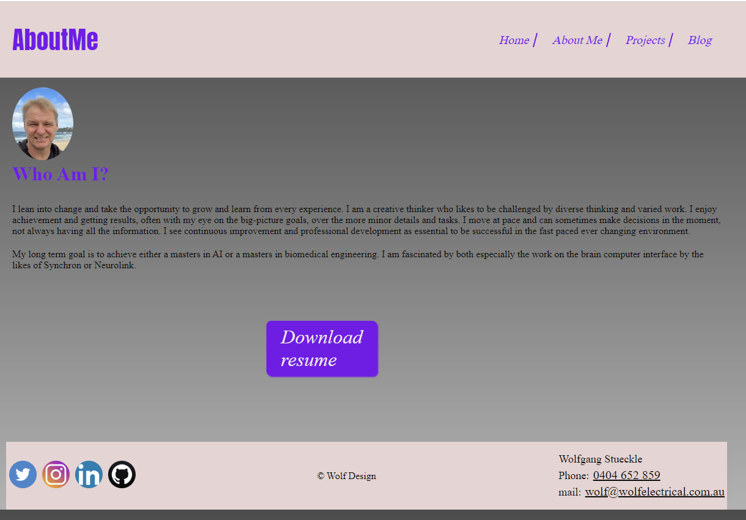
About Me
Notes:
Landing page

Slide 3
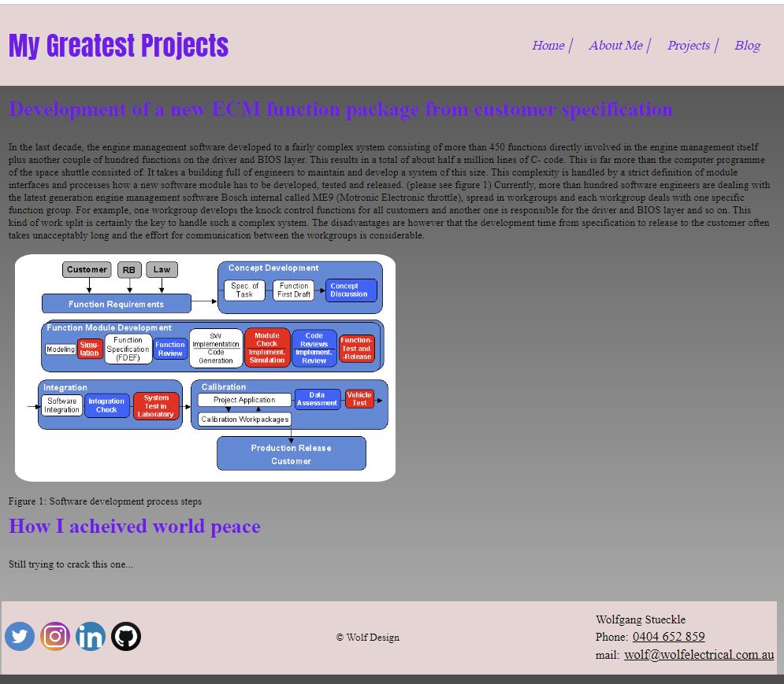
Projects
Notes:
Landing page

Slide 4
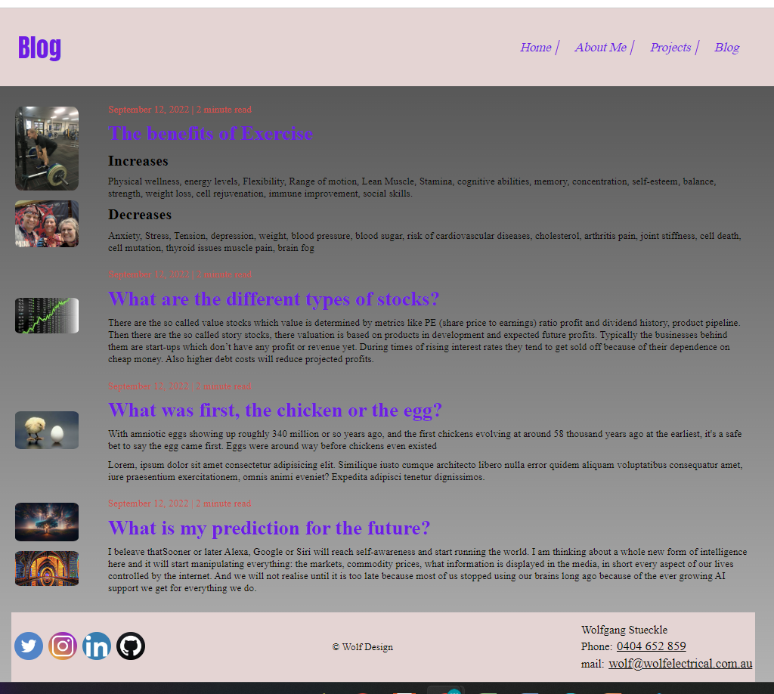
Blog
Notes:
Landing page

Slide 5
Design process and decision making
I Looked at multiple web designs and got inspiration for coding.
I tried to get the best of all of them.

Slide 6
Development process review
Projects-Page: I will add more projects I completed during my career.
Landing –Page: I used the Matterhorn as a background. The additional grey gradient makes the sky even look bluer.
Blog-Page: I used a table to organised text and pictures. I am looking forward to learn how to make this more interactive, so viewers can leave a comment and start a discussion.
Challenges: making the flex box work for the small devices.
Ethical issues: At the project page I explained processes and tools used by my previous employer. I am not sure how far I can go there.
Favourite parts: designing the graphic elements, bringing the design to live
I used a background picture in the landing page. I am courious iif I can use other media too like a background animation or sound.

